Slide 1

lesson 12
PC Operating Systems in Review

Slide 2
UNIX
DOS
The Macintosh Operating System
Windows 3.x
OS/2 Warp
Windows NT
Windows 95 and 98
Linux
Windows 2000
This lesson includes the following sections:

Slide 3
UNIX
UNIX is the oldest operating system used on PCs.
UNIX was the first multi-user, multiprocessor, multitasking operating system available for use on PCs.
Most versions of UNIX use a command-line interface, but some versions offer a GUI.

Slide 4
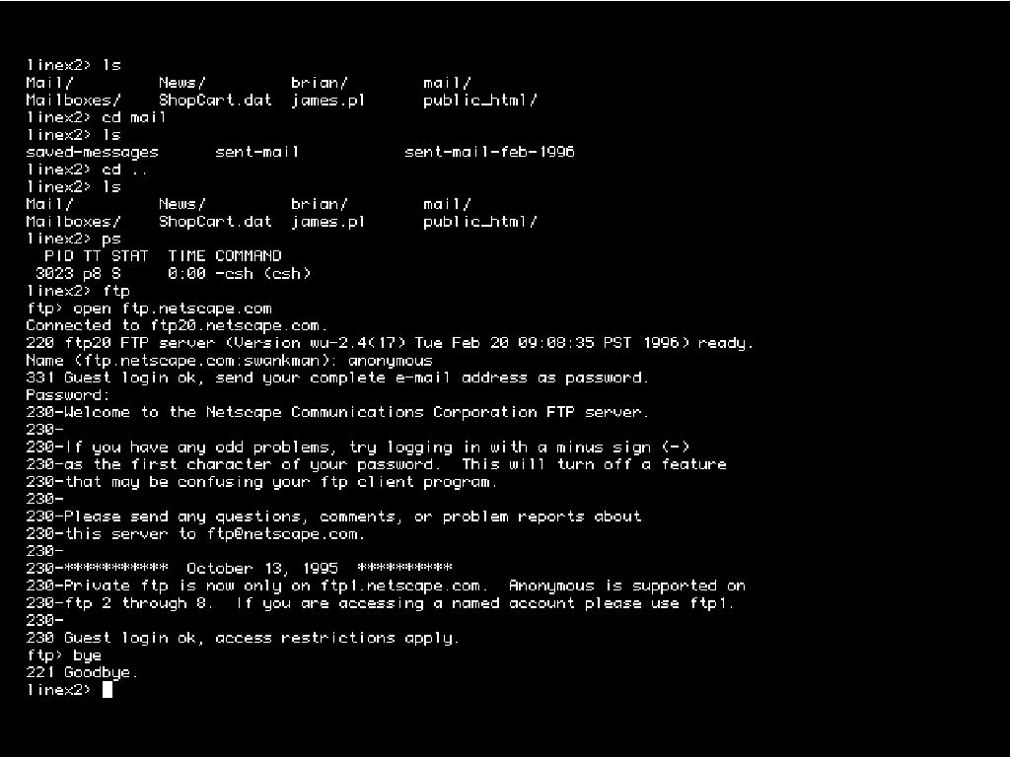

Slide 5
DOS
DOS dominated the operating system market during the 1980s.
DOS is a single-user OS that supports only 640 KB of memory.
DOS features a command-line interface, and does not support multitasking or multiprocessing.
Because DOS provides no interface restrictions, DOS applications can look and function differently.

Slide 6
The Macintosh Operating System
The Macintosh OS supports the graphical nature of the Macintosh computer.
The Mac OS brought the first truly graphical user interface to consumers.
The Mac OS also brought interface conformity to the desktop. All applications running under the Mac OS, therefore, provided the same "look and feel" to the user.

Slide 7
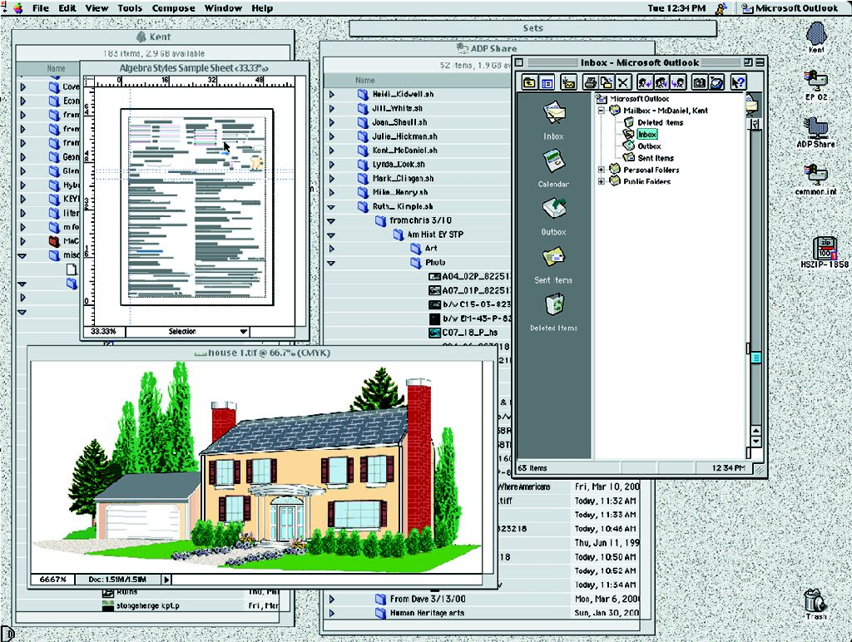

Slide 8
Windows 3.x
Windows 3.0, 3.1, and 3.11 are called the Windows 3.x family.
Windows 3.x brought a GUI and multitasking capabilities to PCs running DOS.
Windows 3.x is an operating environment because it ran on top of DOS, which was the actual OS.

Slide 9
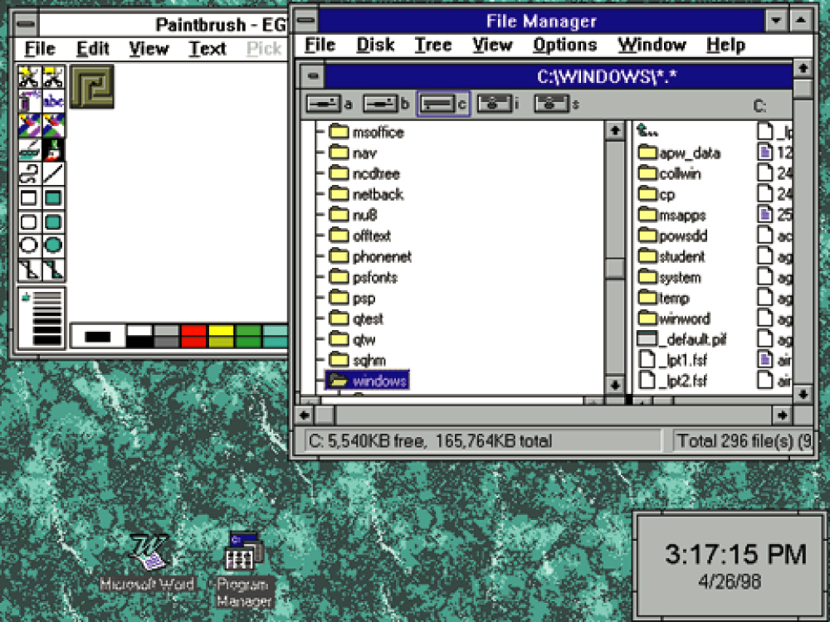

Slide 10
OS/2 Warp
OS/2 Warp was the first true GUI-based operating system for Intel-based PCs.
OS/2 is a multitasking OS that provides support for networking and multiple users.
It was the first PC OS to feature built-in speech recognition capabilities.

Slide 11
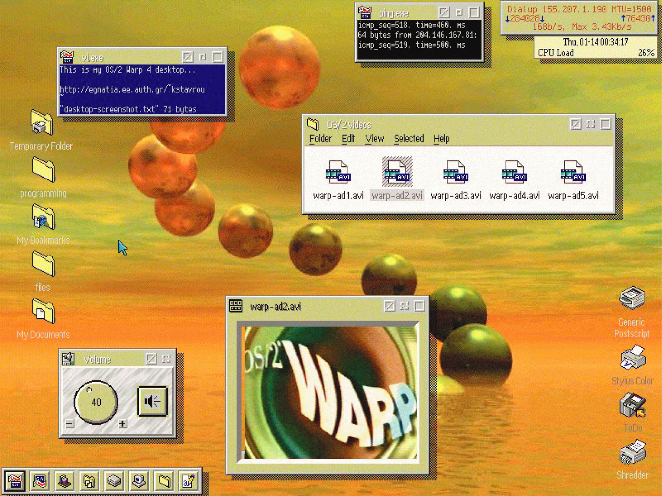

Slide 12
Windows NT
Microsoft's Windows NT was meant as a replacement for DOS, but was too resource- intensive to work on most PCs at the time of its release.
Microsoft issued two versions of Windows NT—Windows NT Workstation and Windows NT Server.
NT is a very powerful and robust OS, resistant to system crashes.

Slide 13
Windows 95 and 98
Windows 95 was Microsoft's first true GUI-based, 32-bit operating system for Intel PCs.
Windows 95 supports multitasking and can run older DOS and Windows 3.x programs.
Windows 98's features include advanced Internet capabilities, an improved user interface, and enhanced file system performance, among others.

Slide 14
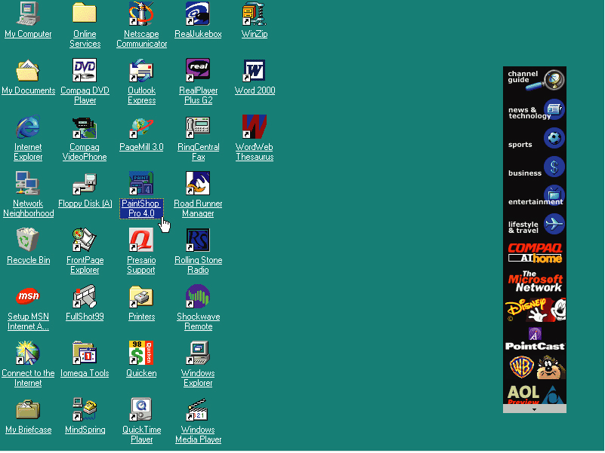

Slide 15
Linux
Linux is a recently developed version of UNIX, which is available for free or at a very low cost from various sources.
Linux is a very powerful 32-bit OS that supports multitasking, multiple users, networking, and virtually any application.
Linux can run on nearly any type of computer.
Because of its power and openness, Linux is attracting many users, including students, teachers, Internet service providers, and others.

Slide 16
Windows 2000
Windows 2000 features the same interface and features of Windows 98, with the file system, networking, power, and stability of Windows NT.
Several versions of Windows 2000 are available, each targeting a specific user or computing environment, from home PCs to large enterprise networks.

Slide 17
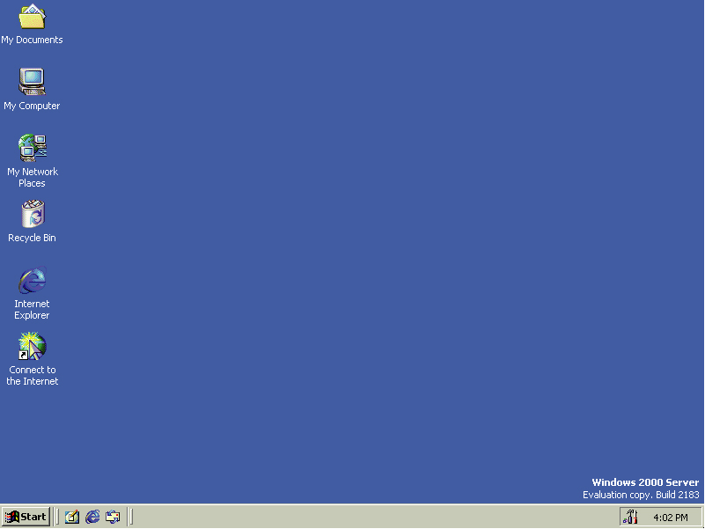

Slide 18
lesson 12 review
List all the major PC operating systems.
Identify some of the limitations of DOS.
List two features that made the Macintosh OS popular.
Differentiate between the terms operating environment and operating system.
List the various versions of Windows.

